Slide 1

GB Energy Market Price Analysis

Slide 2
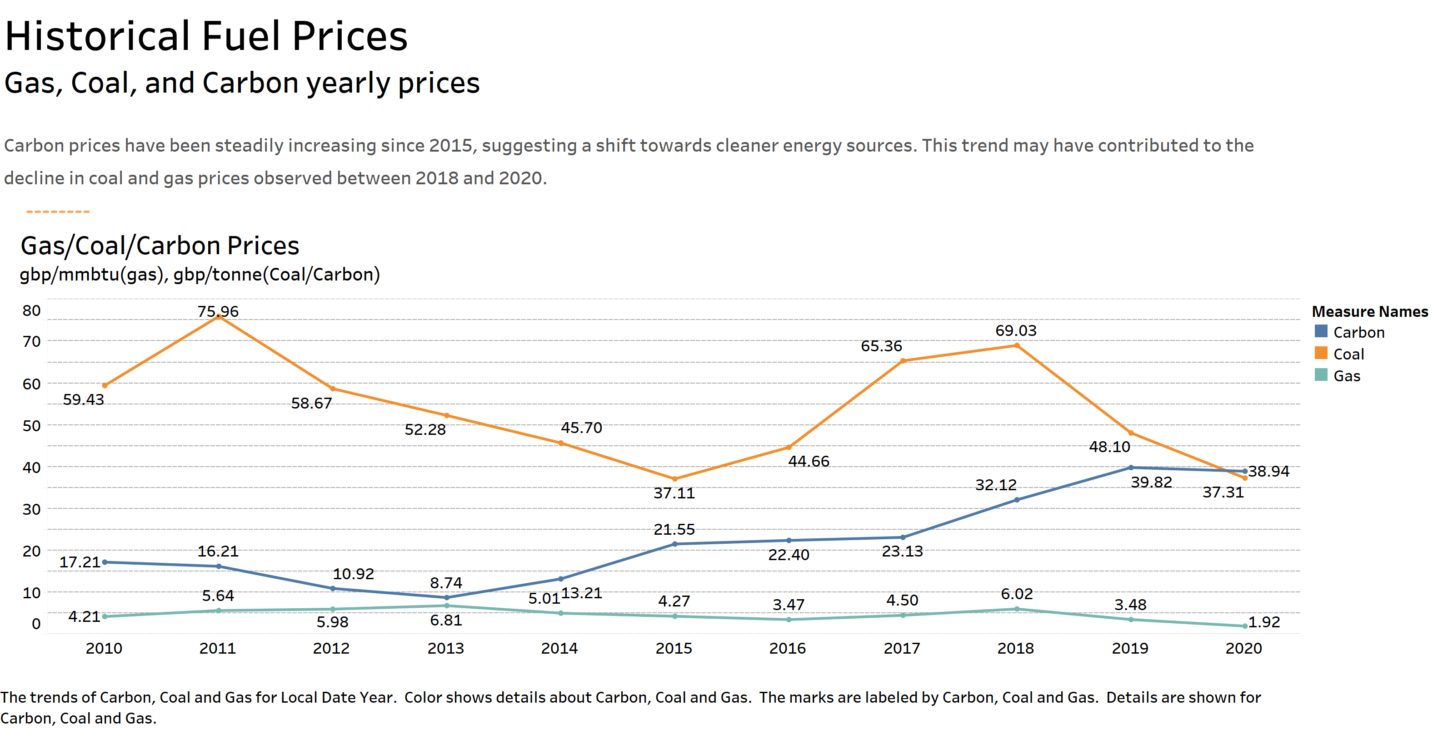

Slide 3
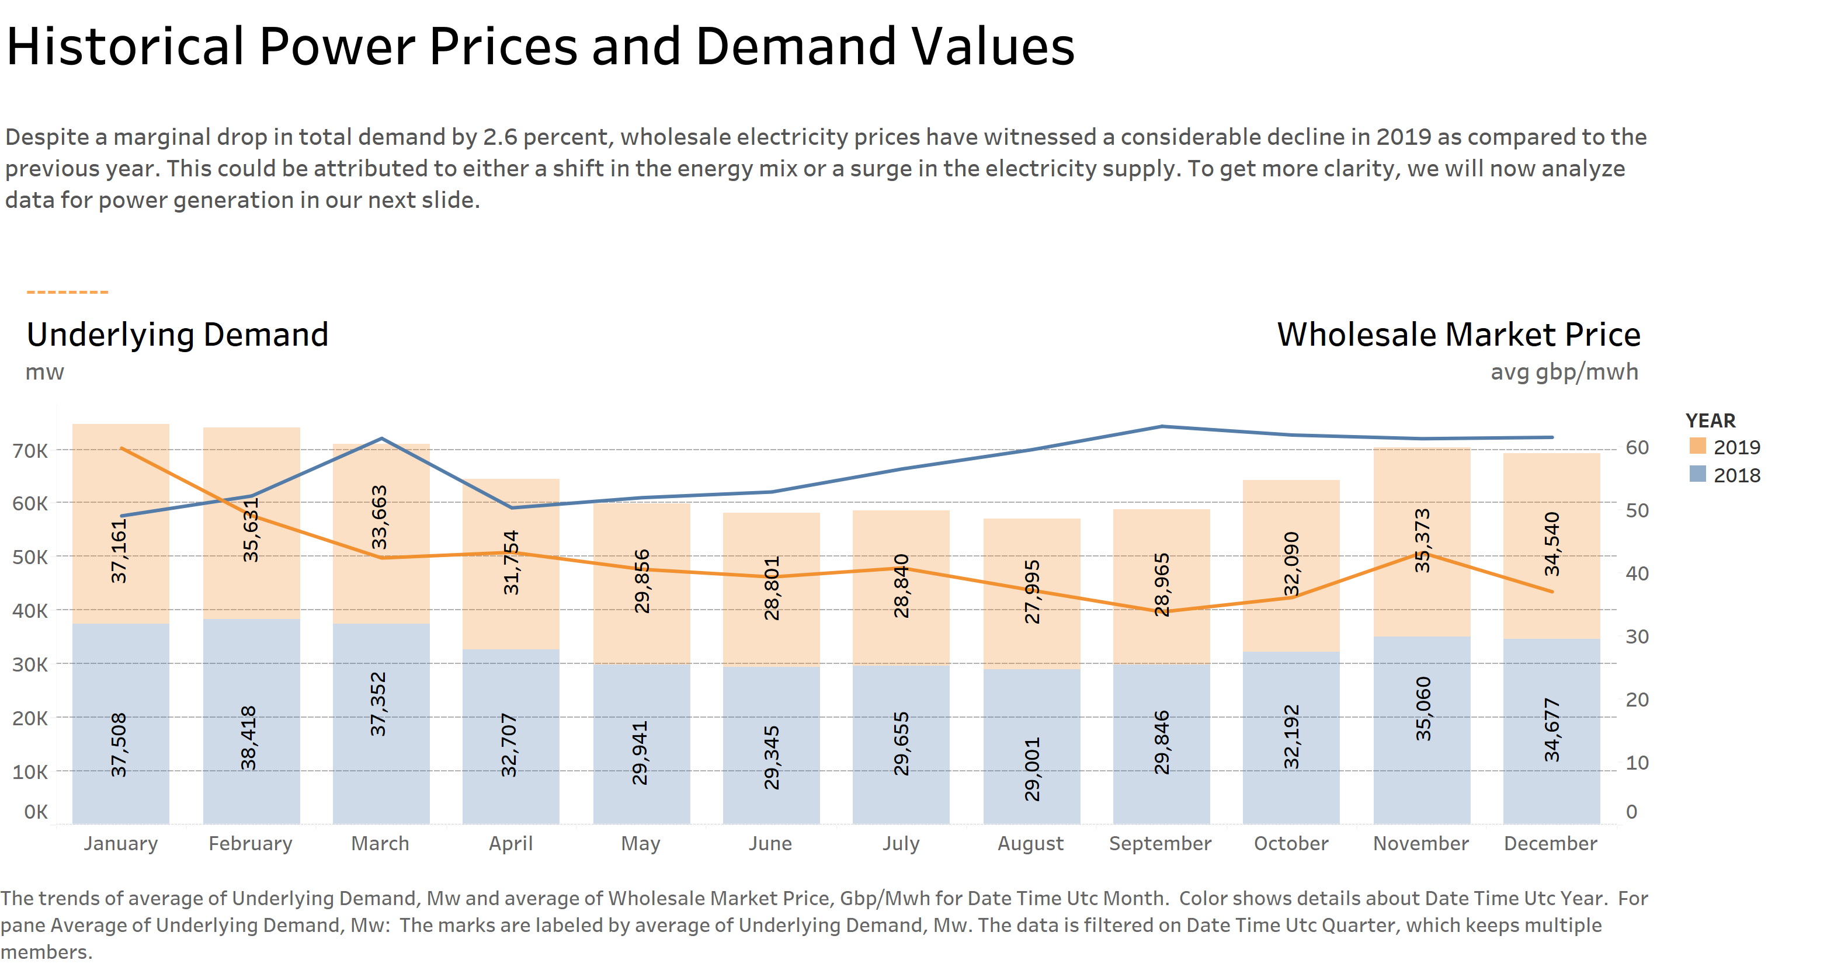

Slide 4
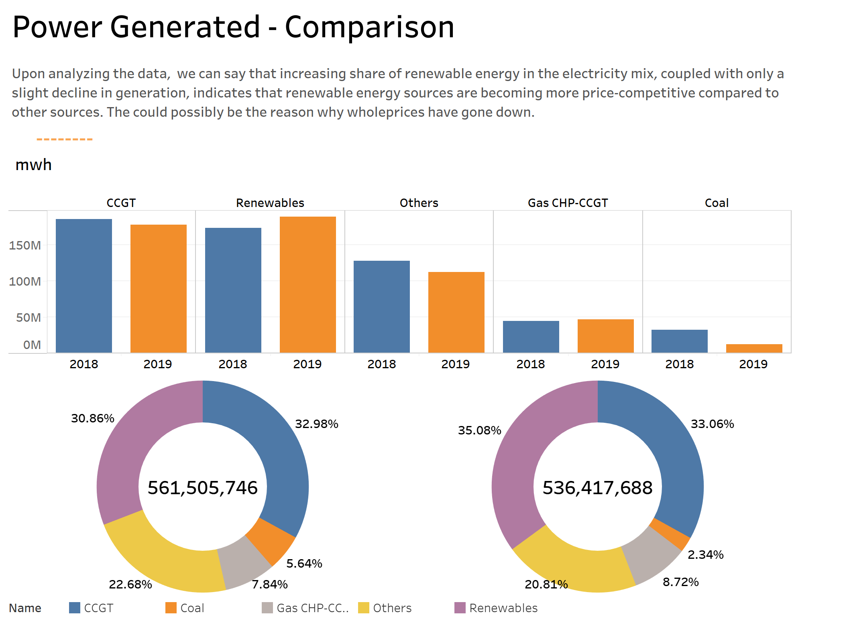
-60%
-4.4%
2019
2018

